Slide 1

Week 3 Writeup
Leslie Dees

Slide 2
Problem 1

Slide 3


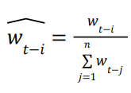
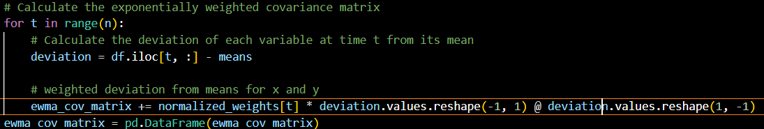

Routine for Exponentially Weighted Covariance Matrix

Slide 4
Exponentially Weighted Covariance Matrix Error
Weights inverted relative to inputs

Slide 5
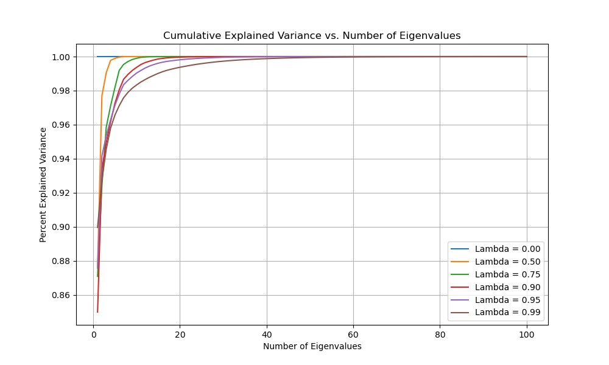
Lambda Variation
PCA to obtain cumulative explained variance based on number of eigenvalues used
As lambda increases, greater number of eigenvalues required to fully explain variance
Low lambda values weight more heavily towards recent historical data
In terms of covariance matrix, more information is contained based on historical data as lambda increases

Slide 6
Problem 2

Slide 7
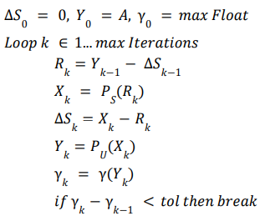
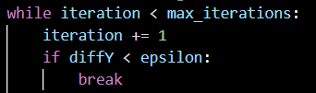
Higham’s 2002 Nearest PSD Function

Slide 8
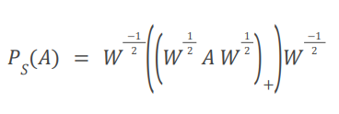
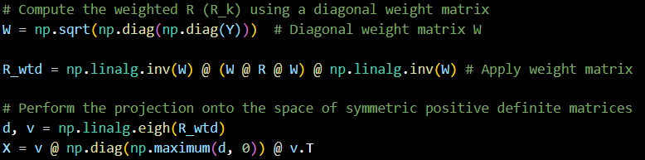
Higham’s 2002 Nearest PSD Function

Slide 9

Higham’s 2002 Nearest PSD Function

Slide 10
Confirmation of PSD
S
Checks for negative eigenvalues
For certain values, very small complex eigenvalues appear (-4.23250844e-15+0.j)
Checking using chol_psd()
Runs without error, therefore confirms that both matrix calculations result in PSD matricies

Slide 11
Results Comparison
As correlation matrix increases in size, Higham runtime increases exponentially
Iterative algorithm could be better at optimization of a matrix with an undefined absolute perfect value
N | near_psd time (seconds) | higham_near_psd time (seconds) | Frobenius Norm
50 | 0.015 | 0.051 | 0.168
100 | 0.031 | 0.150 | 0.259
200 | 0.138 | 0.884 | 0.383
500 | 0.853 | 6.873 | 0.621
750 | 1.481 | 26.840 | 0.765
1000 | 2.715 | 81.77 | 0.889

Slide 12
Problem 3

Slide 13
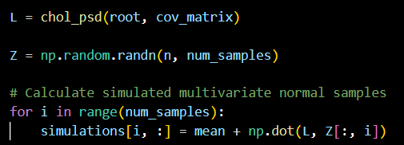
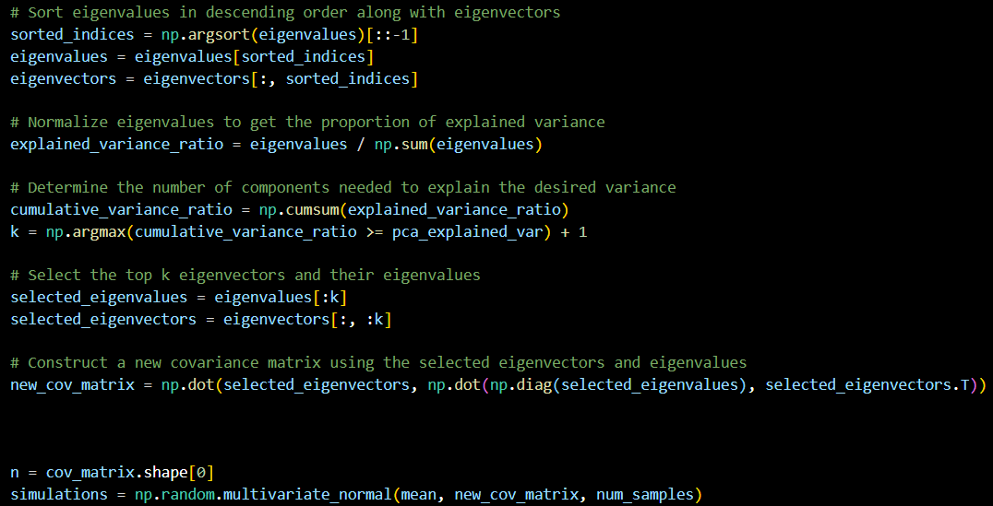
Multivariate Normal Simulation
Direct Simulation
PCA

Slide 14
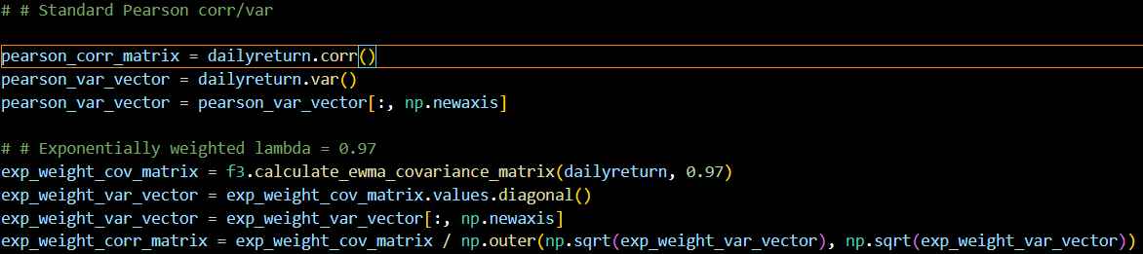
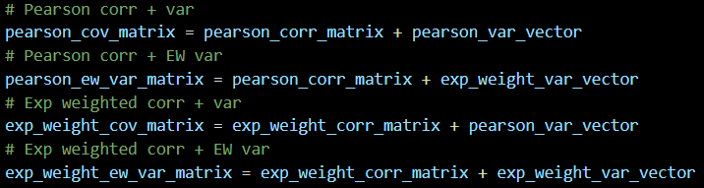
Covariance Matrix Combination Formulations
Calculate corr() and var() from dailyreturn directly
Obtain covariance matrix from function calculation, use to obtain var and corr of exponentially weighted covar matrix

Slide 15
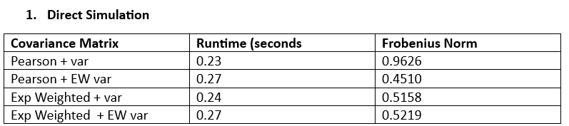
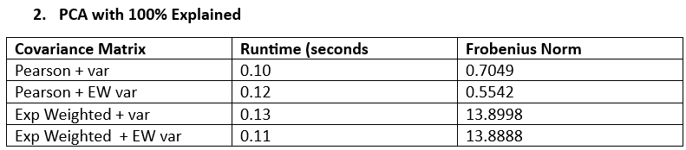
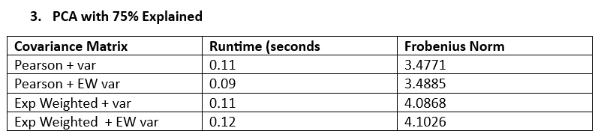

Covariance Matrix Simulation Comparisons

